Slide 1



Streamline Quality Measurement Reporting to Meet State and Federal Requirements
Daniel A. Pollock, M.D. & Robert H. Dolin, M.D.

Slide 2
Conflict of Interest Disclosure
Daniel A. Pollock, M.D. and
Robert H. Dolin, M.D.
have no real or apparent
conflicts of interest to report.

Slide 3
Learning Objectives
Describe challenges that are often associated with data aggregation and reporting of healthcare quality measures
Explain CDC’s role in healthcare quality measure reporting at the state and federal levels
List a minimum of three benefits of using available data standards to leverage EHRs and EHR modules for process and outcome reporting

Slide 4
Overview
The Health Level Seven (HL7) Clinical Document Architecture (CDA) standard streamlines healthcare associated infection (HAI) quality measure reporting to the CDC’s National Healthcare Safety Network (NHSN) by enabling hospitals to aggregate and submit data electronically rather than manually
Use of CDA is expanding rapidly as a national healthcare interoperability standard, and HAI reporting is just one example of its use

Slide 5
Take Home Message #1:
CDA Streamlines Required Reporting
HAI and other clinical quality measure reporting requirements are increasing in the U.S.
The national trend toward greater transparency and accountability in healthcare places a premium on reducing reporting burden
CDC, HL7, and healthcare information technology vendors have collaboratively developed a CDA solution for submitting HAI data to NHSN that enables electronic reporting instead of manual data entry

Slide 6
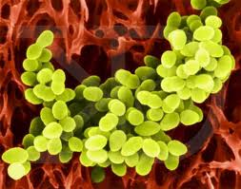
HAIs: A Major Patient Safety Problem
Occur too often - approximately 1 in 20 hospitalized patients in the U.S.
HAI data reported to CDC’s NHSN are used by:
Hospitals to monitor, report, and prevent infections
State and federal agencies for analysis and public reporting
CMS for its payment programs: pay-for-reporting and pay-for-performance

Slide 7

CDC’s System for
HAI Reporting
NHSN was launched by CDC in 2005 and since then it has been adopted for use by 30 states with HAI reporting mandates and by CMS
State and federal reporting requirements account for growth from ˜ 300 hospitals initially to over 5000 hospitals in 2012
Technical design enables manual data entry via a web interface or electronic reporting via CDA

Slide 8
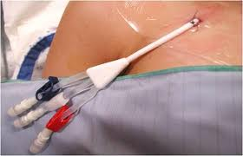
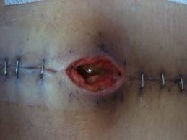
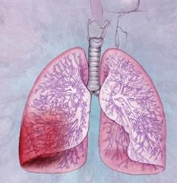

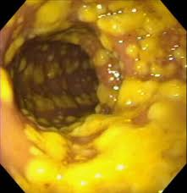
The HAIs that Matter Most
Are Reported to NHSN
Central line associated
bloodstream infections
(CLABSIs)
Surgical site
infections (SSIs)
Ventilator associated events (VAEs)
Catheter associated urinary tract infections (CAUTIs)
Clostridium
difficile
Infections (CDIs)

Slide 9
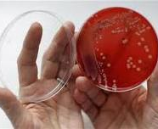
Some Laboratory Identified Events
Are Reported As HAI Proxies*
Methicillin resistant S. aureus
Vancomycin resistant Enterococcus
Multi-drug resistant Acinetobacter
Cephalosporin resistant Klebsiella
Carbapenem resistant Klebsiella
Carbapenem resistant E. coli
*Positive laboratory results that were not present on hospital admission or early in a hospital stay serve as proxy measures for infection and are reported to NHSN

Slide 10



Healthcare Processes Are Reported Because of Their Link to HAI Prevention
Central line
insertion
practices (CLIP)
Influenza
vaccination
coverage
Antimicrobial use and resistance (AUR)

Slide 11





Use of NHSN’s Web Interface for Reporting is Labor Intensive
Paper Records
Data submitted via
secure Internet
connection
NHSN
Servers
Manual methods:
case finding
data collection
data entry
Manual processes are used to prepare and submit records to NHSN, even when healthcare data are available in electronic form
NHSN
web interface
Disparate
Electronic
Data Sources
Hospital

Slide 12
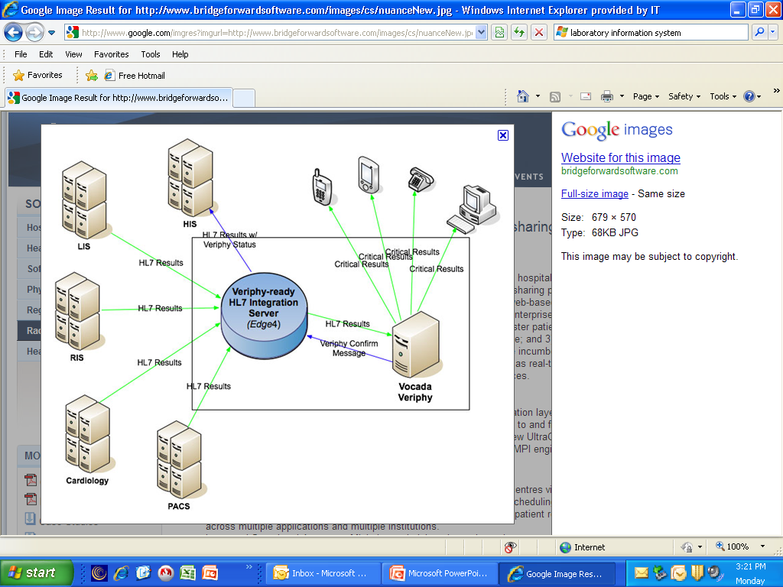

Use of CDA for HAI Reporting to NHSN – Leveraging Electronic Data Sources
Admission
Discharge Transfer System
CDA file submitted via
Electronic Health Record System
NHSN
Servers
file upload or transfer
Laboratory
Information
System
*CDA files are used to submit HAI data to NHSN, obviating the need for manual data entry into the NHSN web interface
Data for NHSN
are processed
and packaged
as CDA files
Infection Control System
Pharmacy
System
Hospital

Slide 13
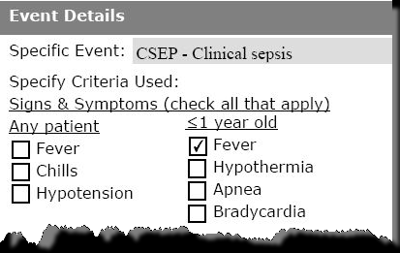
Each CDA Instance Submitted to NHSN is an XML-Encoded Record
NHSN HAI Report Form
XML*
<observation>
<code
codeSystem="2.16.840.1.113883.5.4"
code="ASSERTION"/>
<statusCode code="completed"/>
<value
codeSystem="2.16.840.1.113883.6.96"
codeSystemName=“SNOMED CT"
code="386661006"
displayName=“fever"/>
</observation>
LCBI – Lab Confirmed BSI
* XML = Extensible Markup Language

Slide 14
Templated CDA: Technical Lynchpin for HAI Reporting via CDA to NHSN
CDA is built on the HL7 Version 3.0 Reference Information Model (RIM) which offers advantages for interoperability but has a reputation for complexity
Templates, CDA’s solution for dealing with RIM complexity, are pre-defined specifications for expressing a particular element of clinical data (e.g. blood pressure, HAI instance), the structure of a textual section in a CDA document, or the structure of the CDA header

Slide 15
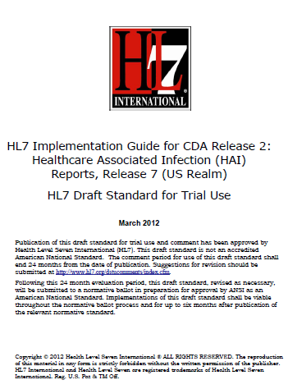
HL7 CDA for HAI Reporting
Implementation Guide (IG)
Essentially a collection of templates and associated vocabulary for creating valid CDA records for submission to CDC’s NHSN
Each IG release is vetted with vendors and submitted to HL7 ballot
CDC commits resources and provides tools for supporting use of CDA to report HAIs
Getting started and getting help with the IG: nhsncda@cdc.gov

Slide 16
NHSN and CDA – Current Status
  NHSN currently accepts CDA files for CLABSI, CAUTI, SSI, CLIP, Laboratory Identified Event, Dialysis Event, and Antimicrobial Use reporting
  Approximately 10% of hospitals that participate in NHSN use a CDA solution for at least some reporting
  Infection control surveillance system vendors are the primary implementers; EHRs implementations are increasing
  Efforts are underway to include HAI reporting via CDA in Stage 3 Meaningful Use

Slide 17
Summing Up: NHSN and CDA
  NHSN’s role as the primary system for HAI reporting mandates in the U.S. places a premium on creating greater efficiencies in the HAI data supply chain
  CDA is an integral part of a larger movement away from manual processes to electronic methods of detecting and reporting HAIs
  The near-term benefits achieved by using CDA to report HAIs to NHSN demonstrate how standards can be leveraged to reap new returns on investments in health information technology

Slide 18
Learning Objectives
Describe challenges that are often associated with data aggregation and reporting of healthcare quality measures
Explain CDC’s role in healthcare quality measure reporting at the state and federal levels
List a minimum of three benefits of using available data standards to leverage EHRs and EHR modules for process and outcome reporting

Slide 19

Meaningful Use and CDA
  Consolidated CDA Implementation Guide:
  A CDA-based representation of common clinical documents (Consultation Note, H&P, Progress Note, Discharge Summary, Operative Note, Procedure Note, Diagnostic Imaging Report)
  Quality Reporting Document Architecture:
  A CDA-based representation of patient-level and aggregate clinical quality data
  Ambulatory Healthcare Provider Reporting to Central Cancer Registries:
  A CDA-based representation of clinical oncology data

Slide 20
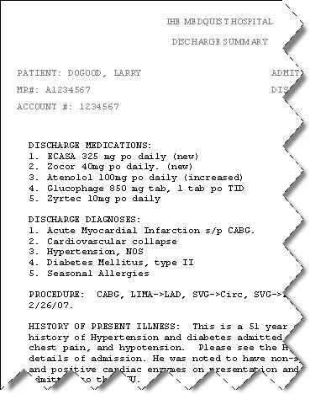
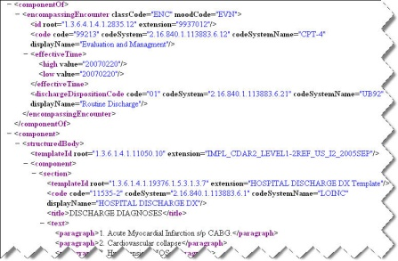
Why is CDA So Popular??
Get the data flowing, get the data flowing, get the data flowing
Incrementally add structure, where valuable to do so
Narrative
Text
HL7 CDA Structured Documents
Coded Discrete Data Elements (via CDA templates)
Decision Support
Clinical Applications
Meaningful Use!
SNOMED CT
Disease, DF-00000
Metabolic Disease, D6-00000
Disorder of carbohydrate metabolism, D6-50000
Disorder of glucose metabolism, D6-50100
Diabetes Mellitus, DB-61000
Type 1, DB-61010
Neonatal, DB75110
Carpenter Syndrome, DB-02324
Insulin dependant type IA, DB-61020

Slide 21
Templated CDA
  Many different kinds of documents
  A bucket of reusable templates
CDA HAI Guide
A CDA document
using CCD templates plus others
A CDA document
using CCD templates plus others
A CDA document using CCD templates
A CDA document using CCD templates
CCD
Chief Complaint
Discharge
Diagnosis
Mode of
Transport
Surgical Finding
Discharge Diet
New Template…
CCD
Demographics
Allergies
Family History
Social History
Vital Signs
Medications
Problems
Payer
Chief Complaint
Discharge
Diagnosis
Mode of
Transport
Surgical Finding
Discharge Diet
New Template…
Demographics
Allergies
Family History
Social History
Vital Signs
Medications
Problems
Payer
. . . .
. . . .
CDA
CDA

Slide 22
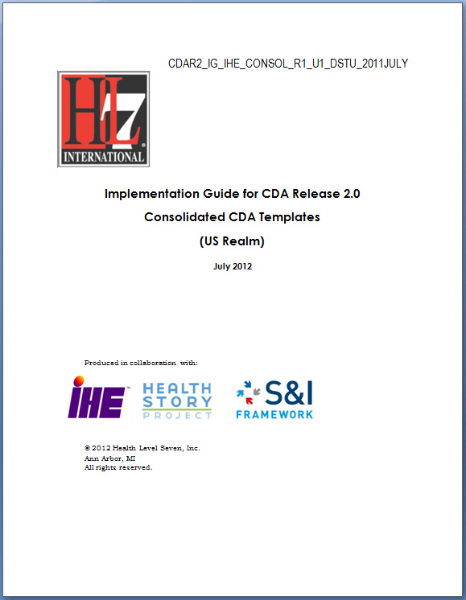
Consolidated CDA
  Many types of documents:
    Continuity of Care (CCD)
    Consultation Note
    Diagnostic Imaging Report
    Discharge Summary
    History & Physical (H&P)
    Operative Note
    Procedure Note
    Progress Note
    Unstructured Document
  A bucket of reusable templates
  www.hl7.org

Slide 23
<section>
<code code="48765-2" codeSystem="2.16.840.1.113883.6.1"
codeSystemName="LOINC"/>
<title>Allergies and Adverse Reactions</title>
<text>
<list>
<item>Penicillin - Hives</item>
<item>Aspirin - Wheezing</item>
<item>Codeine - Itching and nausea</item>
</list>
</text>
<entry>
<observation>
<code code="247472004" codeSystem="2.16.840.1.113883.6.96"
codeSystemName="SNOMED CT" displayName="Hives“/>
<entryRelationship typeCode="MFST">
<observation>
<code code="91936005" codeSystem="2.16.840.1.113883.6.96"
codeSystemName="SNOMED CT"
displayName="Allergy to penicillin"/>
</observation>
</entryRelationship>
</observation>
</entry>
</section>
Allergies and Adverse Reactions
• Penicillin - Hives
• Aspirin - Wheezing
• Codeine – Itching and nausea

Slide 24
Simplifying CDA Implementation
  Templated CDA
  greenCDA

Slide 25
Simplifying CDA via templates
  No need to understand HL7 Reference Information Model
  No need to understand complete CDA standard
  Only need to
    Populate required fields in CDA header
    Map local data to fields in required CDA templates
  HAI templates reuse Consolidated CDA MU templates where possible

Slide 26
greenCDA
  greenCDA is a simplified XML, that maps to full CDA
  greenCDA hides certain CDA complexities (such as moodCodes, fixed attributes, etc).
  greenCDA schemas are modular, corresponding to CDA templates.

Slide 27

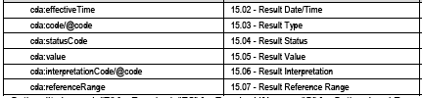
1. Create greenCDA guide
Requirements
greenCDA schema
<result>
<resultID>
<resultDateTime>
<resultType>
<resultStatus>
<resultValue>
<resultInterpretation>
<resultReferenceRange>
</result>

Slide 28
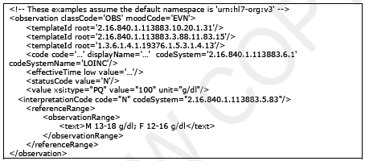
2. Create greenCDA instance
greenCDA instance
<result>
<resultID>
<resultDateTime>
<resultType>
<resultStatus>
<resultValue>
<resultInterpretation>
<resultReferenceRange>
</result>
Conformant CDA instance

Slide 29



Conclusion
Local EHR
National Meaningful Use
Clinical reuse
Decision support
Secondary use
Quality reporting
Notes:
Benefits:
1) Get the data flowing, get the data flowing, get the data flowing
2) Incrementally add structure, where valuable to do so
3) Takes advantage of readily available structured electronic data
4) Can be smoothly integrated with current workflow, supporting frontline clinicians

Slide 30
Thank You!
Dan A. Pollock, M.D.
Surveillance Branch Chief
Division of Healthcare Quality Promotion, CDC
dpollock@cdc.gov
Bob Dolin, M.D., FACP
President & CMO
Lantana Consulting Group
bob.dolin@lantanagroup.com

