Slide 1
Before We Get Started…
To hear the audio, please ensure your speakers are turned on with the volume up - Audio for today’s conference should be coming through your computer speakers.
To submit a question:
Use the “Chat" window, located on the bottom left side of the webinar screen.
Questions will be addressed at the end of the webinar, as time allows.
The slides for this presentation will be available along with the recorded webinar on CDC’s Tune in to Safe Healthcare website. Participants will be notified via e-mail when this information is available.
Notes:
Tune in to Safe Healthcare website: https://www.cdc.gov/infectioncontrol/training/safe-healthcare-webinars.html

Slide 2


Implementation of Antibiotic Stewardship Activities in Critical Access Hospitals
November 18, 2020

Slide 3

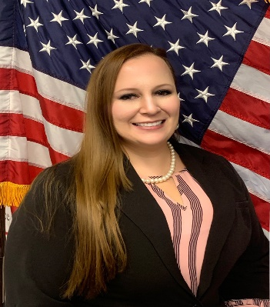
Welcome
Arjun Srinivasan, MD, FSHEA
Associate Director for Healthcare Associated Infection Prevention Programs, CDC’s Division Quality Healthcare Promotion
Natalia Vargas, MPH
Public Health Analyst
HRSA’s Federal Office of Rural Health Policy

Slide 4
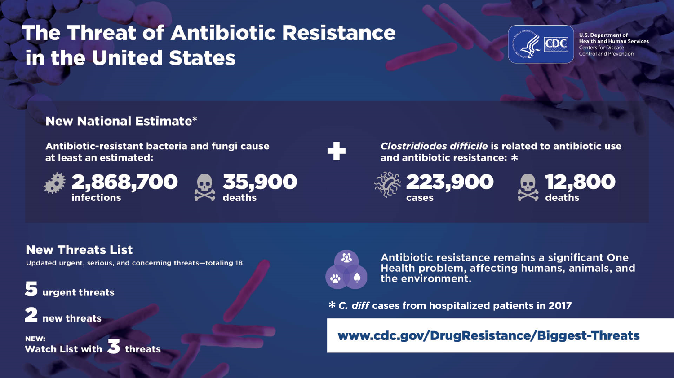
Problem/Infection slide

Slide 5





CARB National Action Plan (2020 – 2025)
GOAL 1: Slow the Emergence of Resistant Bacteria and Prevent the Spread of Resistant Infections
GOAL 2: Strengthen National One Health Surveillance Efforts
GOAL 3: Advance Development and Use of Rapid and Innovative Diagnostic Tests for Resistant Bacteria
GOAL 4: Accelerate Research, Development for New Antibiotics, Other Therapeutics, and Vaccines
GOAL 5: International Collaboration for AR Prevention, Surveillance, Control and Antibiotic Research and Development

Slide 6


Goal 1
Slow the Emergence of Resistant Bacteria and Prevent the Spread of Resistant Infections
Big Bet: Double local efforts by awarding an average of $2.5 million to health departments by 2025.
Examples of other CDC targets:
Decrease healthcare-associated antibiotic-resistant infections by 20% and community-acquired antibiotic-resistant infections by 10% by 2025.
Expand the reach of CDC’s Be Antibiotics Aware and Get Ahead of Sepsis campaigns.
Improve antibiotic use across healthcare settings, plants and animals.
Initiate efforts to improve antibiotic or diagnostic guidelines by 2021.

Slide 7


Antibiotic Stewardship in Critical Access Hospitals
CDC/HRSA Webinar
November 18th, 2020
Natalia Vargas, MPH
MBQIP & Quality Lead, Federal Office of Rural Health Policy
Health Resources and Services Administration (HRSA)

Slide 8

National Rural Health Day 2020
HRSA is hosting a variety of events throughout the week of November 16 to celebrate National Rural Health Day (NRHD) on November 19
Events are open to the public (registration is required for some events)
NRHD is HRSA’s opportunity to showcase the work and accomplishments across the agency supporting rural health
To register for upcoming events, please visit:
https://www.hrsa.gov/rural-health/about-us/rural-healthday.html
Notes:
The National Organization of State Offices of Rural Health sets aside the third Thursday of every November to celebrate National Rural Health Day. National Rural Health Day is an opportunity to “Celebrate the Power of Rural” by honoring the selfless, community-minded, “can do” spirit that prevails in rural America, gives us a chance to bring to light the unique healthcare challenges that rural citizens face, and showcase the efforts of rural healthcare providers, State Offices of Rural Health and other rural stakeholders to address those challenges.

Slide 9

Federal Office of Rural Health Policy
Notes:
The Federal Office of Rural Health Policy (FORHP) was created in 1987 to advise the Secretary of the U.S. Department of Health and Human Services on health care issues impacting rural communities, including: Access to quality health care and health professionals; Viability of rural hospitals; and Effect of the Department’s proposed rules and regulations, including Medicare and Medicaid, on access to and financing of health care in rural areas.
In line with the mission of the Health Resources and Services Administration (HRSA), FORHP helps increase access to care for underserved populations and build health care capacity through several programs, including The Hospital State Division’s MBQIP
FORHP provides affordable, accessible, high quality, sustainable, and innovative services that serve rural America through the initiatives that we support

Slide 10

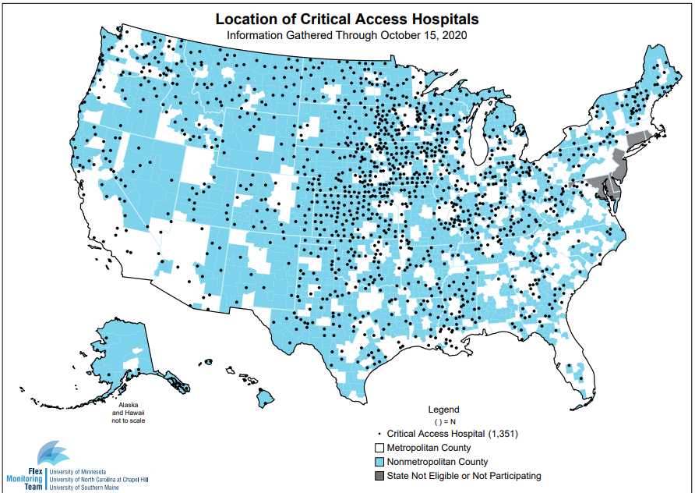

Quality Improvement in Critical Access Hospitals
Notes:
What do we do? Support 1,351 Critical Access Hospitals (CAHs) participate in MBQIP (99% of CAHs nationwide). Margaret Hospital is a 15-bed CAH in NY; Canola fields in ID (picture below). In alignment with the goals outlined in the 2020 HHS Rural Action Plan, FORHP seeks to provide affordable, accessible, high quality, sustainable, and innovative services that serve rural AmericaProgram Participation: Launched reporting in 2011, required in FY 2015; 99% of CAHs signed an MOU by FY2019

Slide 11
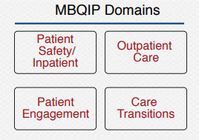
Program Overview
Medicare Rural Hospital Flexibility (Flex) Grant supports quality improvement (QI) efforts across 45 states through the Medicare Beneficiaries Quality Improvement Project (MBQIP)
FORHP funds the Flex Monitoring Team at the University of Minnesota and a Rural Quality Improvement Technical Assistance project at Stratis Health to support CAHs in the voluntary reporting of quality measure data
FORHP requires MBQIP participation and annually recognizes top 10 performing states who achieved the highest reporting rates and improvement levels
MBQIP’s primary aim is to increase reporting of quality data to drive QI based on a common set of rural-relevant hospital metrics within 4 measure domains:

Slide 12
HRSA Collaboration with CDC
2014
CDC releases Vital Signs Report
2016
HHS establishes National Action Plan (i.e., CARB)
2018
FORHP establishes policy for ASP implementation in CAHs
2019 FORHP/CDC track over 70% of CAHs reporting
2017 FORHP/CDC implement ASP measure
2020 GAO releases antibiotic resistance report
MBQIP focuses on strengthening collaborations with HHS/CDC on the judicious use of antibiotics
Notes:
In 2014, the CDC issued a report encouraging all US hospitals to implement ASPs and released the Core Elements of Hospital Antibiotic Stewardship Programs (ASPs) to support this implementation
In 2016, the National Action Plan for Combating Antibiotic Resistant Bacteria (CARB) set a goal for all acute care hospitals to have ASPs in place by 2020
In 2018, FORHP followed suit by requiring Critical Access Hospitals participating in MBQIP to implement ASPs and report on the CDC’s 7 Core Elements of Antibiotic Stewardship by August 31, 2022
Antibiotic Stewardship is reported under the MBQIP Patient Safety/Inpatient Domain
In collaboration with CDC, FORHP monitors uptake of Critical Access Hospital ASPs with the National Healthcare Safety Network (NHSN) Annual Hospital Survey

Slide 13
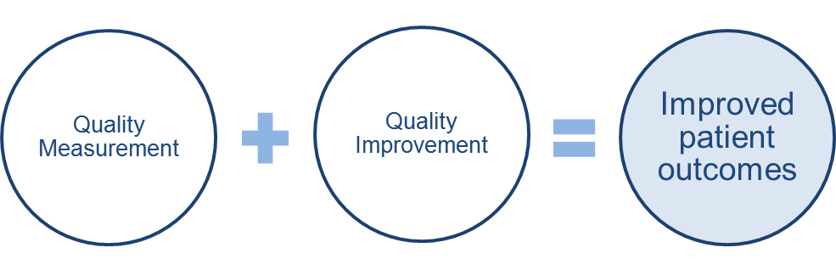
Current Goals with Antibiotic Stewardship Programs
Improve state capacity to use quality measure data to demonstrate improvements and opportunities to support ASP implementation
Improve CAH reporting on NHSN; and identify quality improvement (QI) opportunities based on the 7 Core Elements of Antibiotic Stewardship
Identify challenges in rural hospitals for reporting and uptake of ASP measure

Slide 14

Contact Information
Natalia Vargas:
Nvargas@hrsa.gov
MBQIP Mailbox:
MBQIP@hrsa.gov
MBQIP Website:
https://www.hrsa.gov/rural-health/rural-hospitals/mbqip

Slide 15






Connect with HRSA
Learn more about our agency at:
www.HRSA.gov
Sign up for the HRSA eNews
FOLLOW US:
Notes:
HRSA is on four social media platforms. We encourage you to follow along and share our content on Twitter, Facebook, LinkedIn and Instagram to stay up-to-date on the latest HRSA news. Our account/handle on each platform is @HRSAgov.
Additionally, we also encourage you to sign up for HRSA’s e-News, a biweekly email of comprehensive HRSA news, and to sign up for HRSA press releases. You can also visit our website www.HRSA.gov for more detailed information about all of our programs.

Slide 16


Introduction of Speakers
Erin O'Leary, MPH
Data Analyst, Surveillance Branch
CDC’s Division Quality Healthcare Promotion
Lantana Consulting Group
Emily Spivak, MD, MHS, FIDSA
Associate Professor of Medicine
Antimicrobial Stewardship Medical Director
University of Utah Health and Salt Lake City VA

Slide 17
Objectives
Discuss the 2019 NHSN Annual Hospital Survey results for the antibiotic stewardship program Core Element uptake stratified by facility type, bed size, and teaching status.
Provide practical suggestions for enhancing stewardship activities in critical access hospitals.

Slide 18
Speaker disclosures
The speakers have no financial relationship(s) or disclosures. The conclusions in this talk are the speakers’ and do not necessarily represent the Centers for Disease Control and Prevention or the Veterans Health Administration.

Slide 19
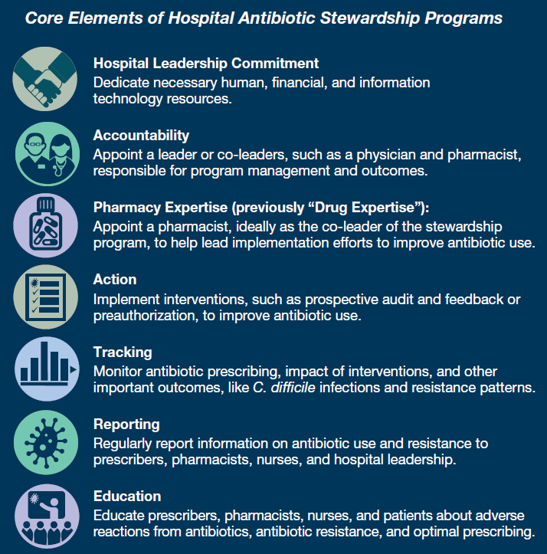

Slide 20
NHSN Annual Hospital Survey
Hospitals participating in the National Healthcare Safety Network (NHSN) complete an annual online survey, which includes questions on:
  Facility demographics
  Laboratory practices
  Infection control practices
  As of 2014, questions specific to antibiotic stewardship programs (ASPs)
Survey typically completed by a hospital’s infection preventionist
Staff who complete ASP questions are encouraged to request assistance from pharmacists and/or physicians who focus on ASPs or infectious diseases, or members of pharmacy & therapeutics committee

Slide 21
Survey questions and Core Elements
Annual surveys summarize information and events taking place in hospitals during the previous full calendar year
  2019 surveys are completed by facilities early 2020
ASP portion of the 2019 annual survey is composed of 10 required and 9 optional questions
CDC uses responses to required questions to assess whether facilities meet criteria for each of the 7 Core Elements
CDC tracks Core Element uptake by comparing the percentage of facilities meeting each element and all 7 elements each year
  By facility type, teaching status, hospital bed size, etc.

Slide 23
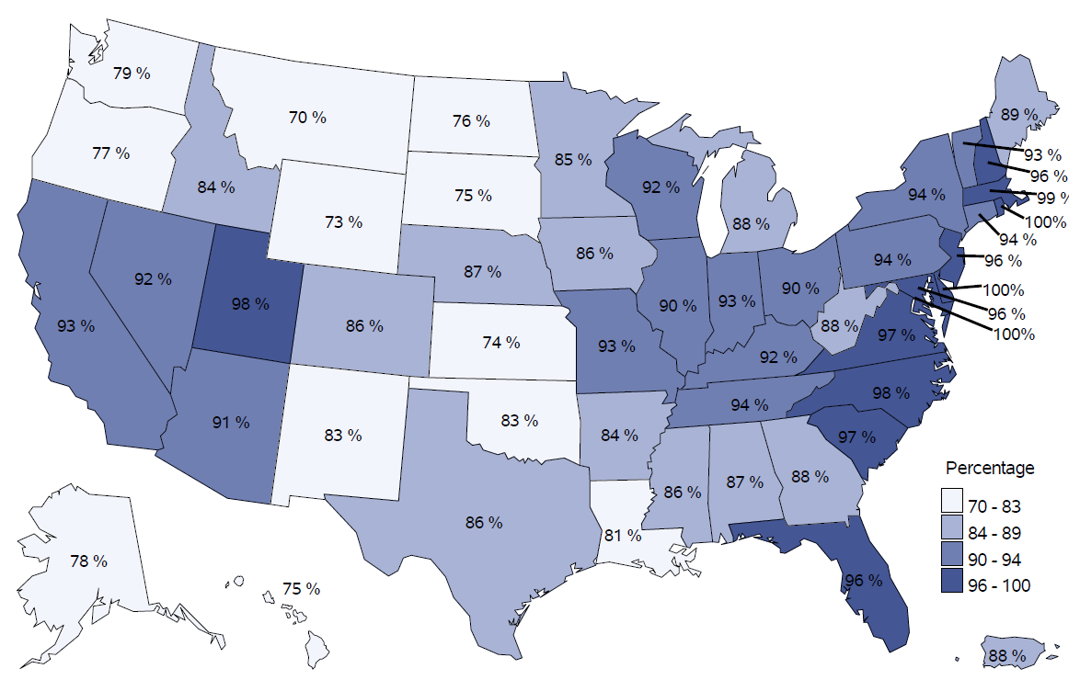
Core Element uptake, by state

Slide 25
Percentage of hospitals meeting all 7 Core Elements, by hospital characteristic, 2014-2019
Characteristic | 2014 | 2015 | 2016 | 2017 | 2018 | 2019
Overall | 40.9% | 48.1% | 64.1% | 76.4% | 84.8% | 88.9%
Facility Type
Children's hospital | 50.0% | 53.2% | 73.9% | 86.0% | 91.9% | 90.5%
General acute care hospital | 44.6% | 53.1% | 69.5% | 81.9% | 88.5% | 92.0%
Surgical hospital | 33.6% | 45.4% | 58.1% | 77.3% | 79.9% | 87.7%
Critical access hospital | 19.6% | 26.3% | 43.0% | 57.8% | 73.2% | 79.5%
Bed Size
≤50 beds | 23.6% | 31.1% | 46.0% | 61.4% | 75.4% | 81.8%
51 - 200 beds | 40.4% | 49.6% | 69.0% | 82.5% | 88.6% | 91.6%
>200 beds | 58.4% | 66.1% | 81.5% | 90.7% | 93.9% | 96.2%
Teaching Status
Major teaching | 55.4% | 63.4% | 76.3% | 86.4% | 91.0% | 93.8%
Non-teaching/undergrad | 35.6% | 42.4% | 58.5% | 71.4% | 81.1% | 85.7%

Slide 27
Percentage of hospitals meeting each Core Element, by facility type, 2019 annual survey

Slide 28
Hospital Leadership Commitment
Priority examples:
  Giving stewardship program leader(s) time to manage the program and conduct daily stewardship interventions.
  Providing resources, including staffing, to operate the program effectively.
  Having regular meetings with ASP leaders to assess the resources needed to accomplish the hospital’s goals for improving antimicrobial use (AU).
  Appointing a senior executive leader to serve as a point of contact or “champion” for the stewardship program to help ensure that the program has resources and support to accomplish its mission.
  Reporting stewardship activities and outcomes (including key success stories) to senior leadership and the hospital board on a regular basis.

Slide 29
Priority examples, 2019 uptake:
Hospital Leadership Commitment
Percentage of hospitals meeting priority examples of LEADERSHIP COMMITMENT | General acute care | Children's | Surgical | Critical access
 | n=3572 | n=95 | n=146 | n=1144
Facility leadership has demonstrated a commitment to ASP by allocating information technology resources to support ASP efforts | 78.6% | 89.5% | 62.3% | 66.3%
Our facility's antibiotic stewardship physician leader has antibiotic stewardship responsibilities in their contract or job description | 46.8% | 66.3% | 27.4% | 12.9%
Our facility's antibiotic stewardship pharmacist leader has antibiotic stewardship responsibilities in their contract or job description | 55.0% | 61.1% | 37.0% | 29.6%
All 3 priority examples of Leadership Commitment | 29.7% | 45.3% | 11.6% | 8.1%

Slide 30
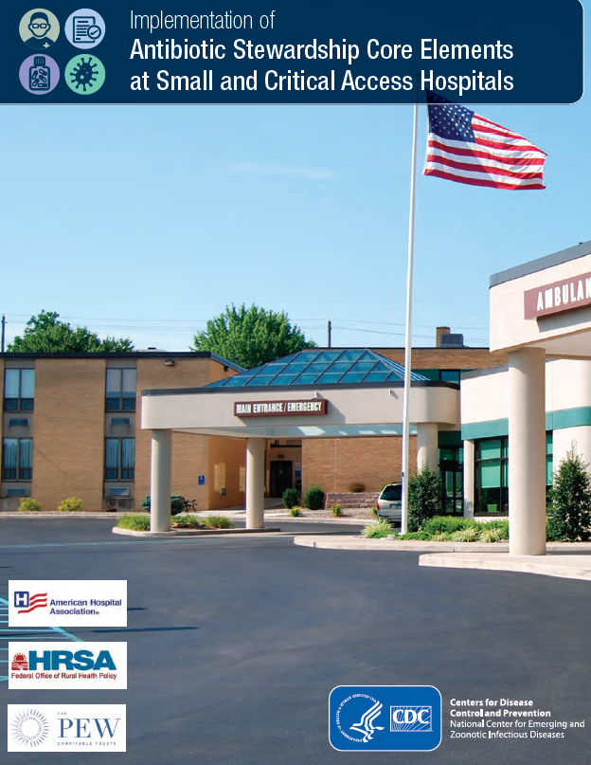
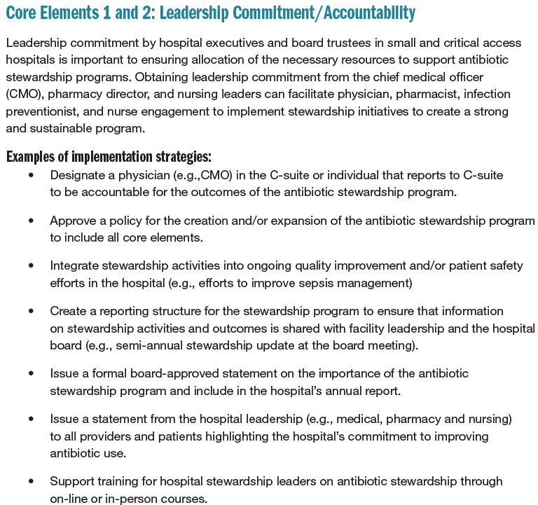
https://www.cdc.gov/getsmart/healthcare/implementation/core-elements-small-critical.html

Slide 31
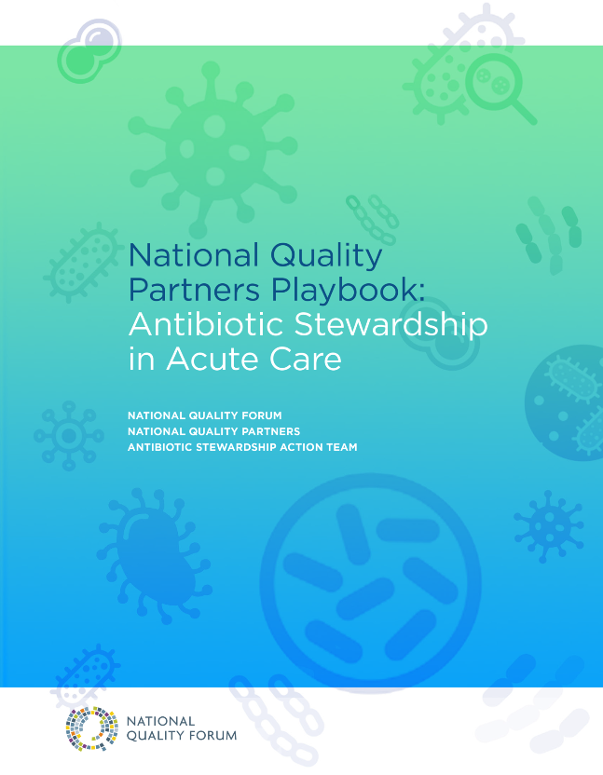
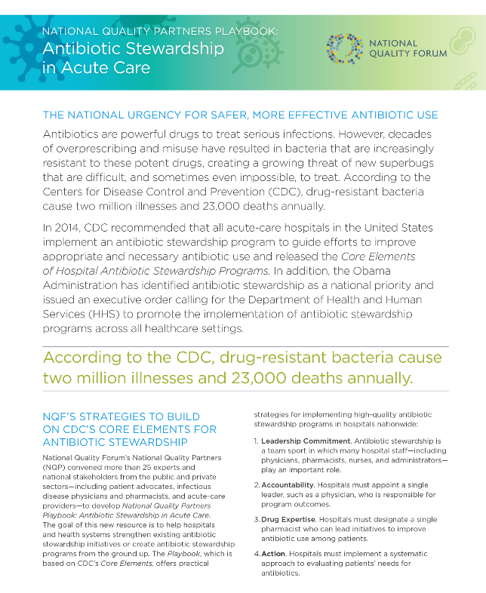
http://www.qualityforum.org/Publications/2016/05/National_Quality_Partners_Playbook__Antibiotic_Stewardship_in_Acute_Care.aspx

Slide 32
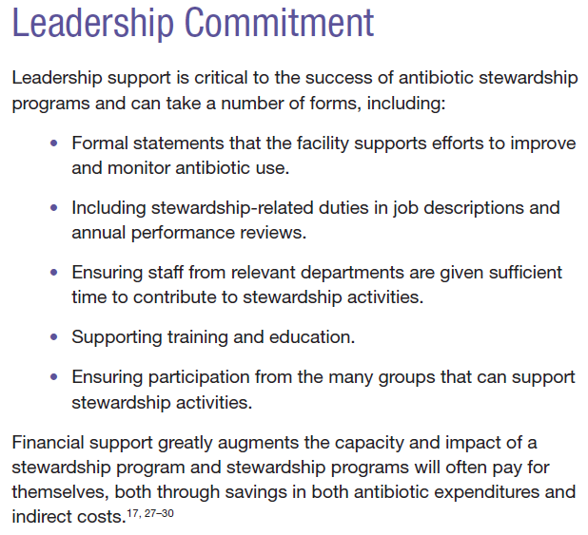
Hospital Leadership Commitment
Stewardship Program Policy
  Background/Purpose/Goals
  Scope – what patients you cover (inpatient, outpatient), where you fall in organizational chart
  Define who the team is and individual responsibilities
  Describe interventions and tracking
  Who you report to, what you report and when

Slide 33
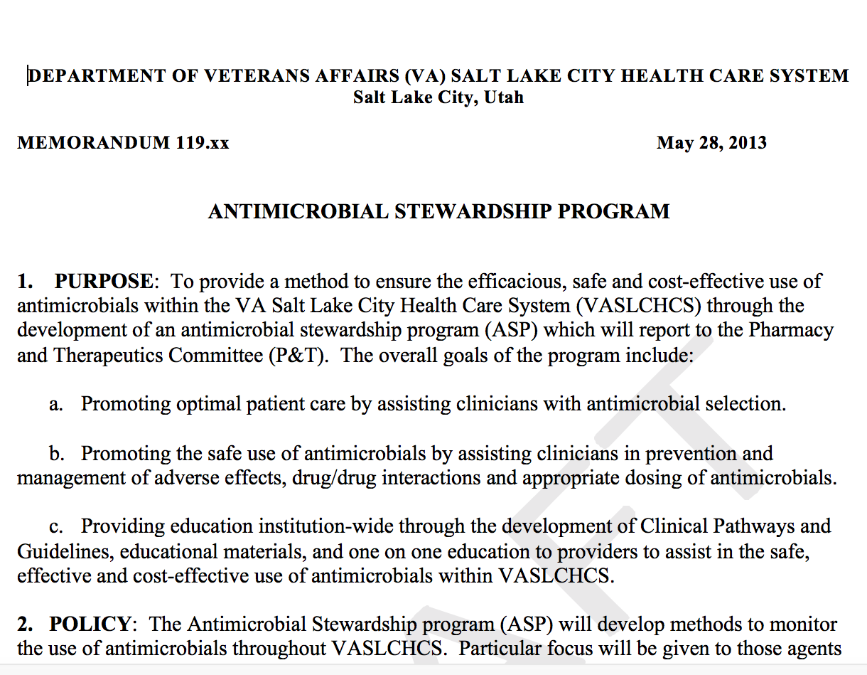


Slide 34
Accountability
Most hospitals have found a co-leadership model to be effective.
If a non-physician is the ASP leader, designate a physician who can serve as point of contact and support for the non-physician program leader.
Regular “stewardship rounds” for the co-leaders, or the non-physician lead and the supporting physician can strengthen program leadership.
Expand rounds to prescribers (e.g., handshake stewardship).

Slide 35
Facility leader(s) accountable for ASP outcomes:
Accountability
Co-led ASPs are more likely to meet all 7 Core Elements compared to physician-led, pharmacist-led, and other-led programs
Stewardship Lead(s) | 2015 | 2016 | 2017 | 2018 | 2019
Co-led | 70.0% | 75.8% | 86.0% | 91.5% | 94.3%
Physician | 67.1% | 75.1% | 83.1% | 86.8% | 89.1%
Pharmacist | 54.7% | 63.3% | 73.9% | 84.1% | 86.9%
Other | 53.7% | 51.5% | 50.0% | 66.0% | 76.4%

Slide 36
Facility leader(s) accountable for ASP outcomes
Accountability
Co-led ASPs are becoming more common

Slide 37
Accountability
Facility leader(s) accountable for ASP outcomes:
While 61% of all hospitals reported co-led programs in 2019, results differ by facility type and bed size
Stewardship Lead | General acute care | Children’s | Surgical | Critical access | >200 beds | 51-200 beds | ≤50 beds
None | 1.8% | 2.1% | 3.4% | 5.7% | 0.2% | 1.5% | 5.5%
Co-led | 68.5% | 66.3% | 47.9% | 38.5% | 80.3% | 65.8% | 43.8%
Physician | 9.1% | 17.9% | 10.3% | 8.2% | 10.4% | 9.1% | 8.2%
Pharmacist | 19.5% | 11.6% | 34.2% | 38.7% | 9.1% | 22.6% | 35.8%
Other | 1.1% | 2.1% | 4.1% | 8.9% | 0.0% | 1.1% | 6.6%

Slide 38
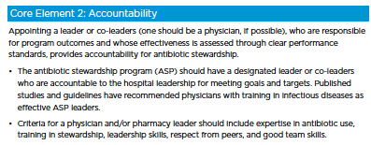
Accountability
Doesn’t have to be ID physician…
Hospitalist or Nurse Practitioner
who is passionate
Seek out Antimicrobial Stewardship Training
Involve clinical champions from high impact areas (ICUs, Surgery, Emergency Medicine, etc.)
Contract with ID groups to provide leadership and expertise (part-time, off site, telemedicine)
Enroll in Collaborative or ECHO/Mentorship Model
*Still need local leader
Need dedicated time and salary support and reporting structure for accountability.

Slide 39
Pharmacy Expertise
Highly effective hospital antibiotic stewardship programs have strong engagement of pharmacists.
CDC has several posters for hospital pharmacists highlighting key stewardship interventions for pharmacists.
https://www.cdc.gov/antibiotic-use/community/materials-references/print-materials/index.html

Slide 40
Pharmacy Expertise
High uptake of pharmacy expertise across all facility types (98.6% in general acute care, 94.8% in critical access hospitals)
Critical access hospitals are less likely to have co-led programs and more likely to have pharmacist-led programs
Percentage of hospitals meeting PHARMACY EXPERTISE criteria | General acute care | Children's | Surgical | Critical access
 | n=3572 | n=95 | n=146 | n=1144
Our facility has a pharmacist leader or co-leader responsible for ASP outcomes | 88.0% | 77.9% | 82.2% | 77.2%
Our facility has a physician or "other" leader responsible for ASP outcomes but there is at least one pharmacist responsible for improving AU at our facility | 9.9% | 20.0% | 13.7% | 14.9%
Our facility does NOT have a leader but does have a committee responsible for antibiotic stewardship and a pharmacist is a member of that committee | 0.6% | 0.0% | 1.4% | 2.7%

Slide 41
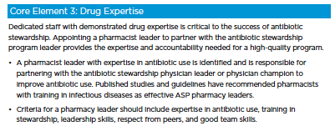
Pharmacy Expertise
Doesn’t have to be ID trained pharmacist
Seek out Antimicrobial Stewardship Training
Pharmacist role is
integral…if have passionate pharmacist with leadership skills consider contracting out to ID MD group for expertise and physician accountability

Slide 42
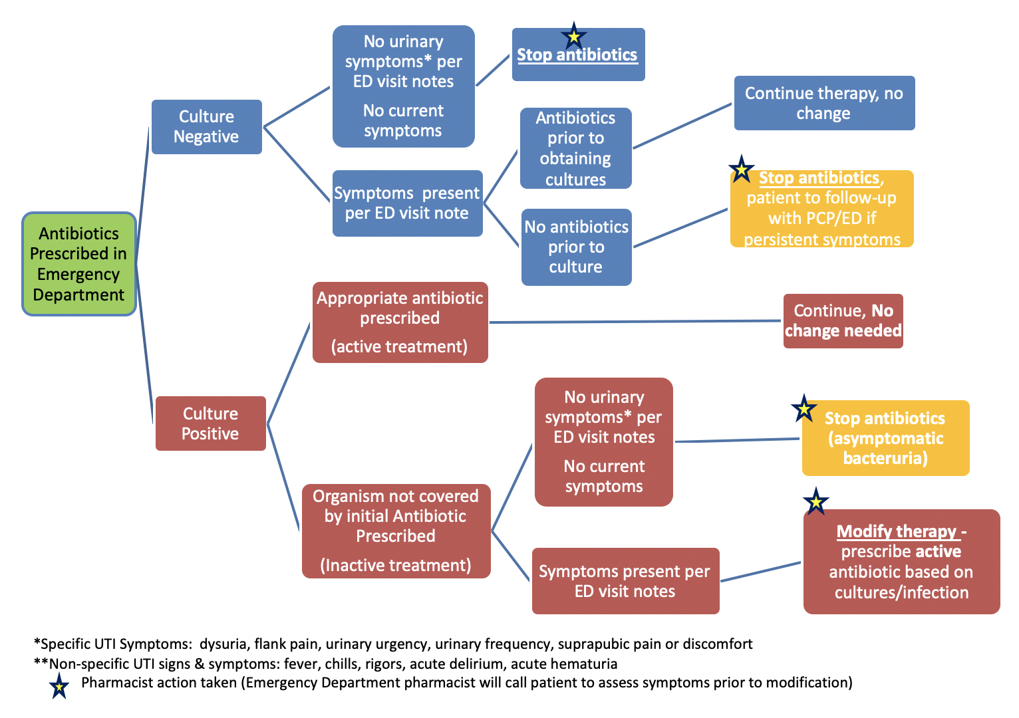
ED Pharmacist Urine Culture Intervention
Run report Monday – Friday of urine cultures collected in ED
Review chart based on urine culture result
Pharmacists leave notes for interventions

Slide 43
Action
Priority Interventions
(Prospective Audit & Feedback, Preauthorization, and Facility Specific Treatment Guidelines)
Infection-based Interventions
Nursing-based Inventions
Microbiology-based Interventions
Provider-based Interventions
Pharmacy-based Interventions
Notes:
The 2019 update has additional examples of interventions which are stratified to “priority” and “other”. The “other” interventions are categorized as infection-based, provider-based, pharmacy-based, microbiology-based, and nursing-based interventions.
Priority interventions include prospective audit and feedback, preauthorization, and facility-specific treatment recommendations. Evidence demonstrates that prospective audit and feedback and preauthorization improve antibiotic use and are recommended in guidelines as “core components of any stewardship program”. Facility-specific treatment guidelines can be important in enhancing the effectiveness of prospective audit and feedback and preauthorization.
The 2019 update emphasizes the importance of actions focused on the most common indications for hospital antibiotic use: lower respiratory tract infection (e.g., community-acquired pneumonia), urinary tract infection, and skin and soft tissue infection.
The antibiotic timeout has been reframed as a useful supplemental intervention, but it should not be a substitute for prospective audit and feedback.
A new category of nursing-based actions was added to reflect the important role that nurses can play in hospital antibiotic stewardship efforts.

Slide 44
Priority interventions to improve antibiotic use
Action
92% of CAHs have facility-specific treatment guidelines, similar to other facility types, but CAHs are less likely to have PAF and preauthorization interventions in place
Percentage of hospitals meeting priority ACTION interventions to improve antibiotic use | General acute care | Children's | Surgical | Critical access
 | n=3572 | n=95 | n=146 | n=1144
Prospective audit and feedback (PAF) | 74.9% | 81.1% | 58.2% | 47.1%
Preauthorization | 52.7% | 52.6% | 39.0% | 20.0%
Facility-specific treatment guidelines | 94.2% | 93.7% | 88.4% | 91.7%
PAF and Preauthorization only | 1.7% | 2.1% | 2.1% | 0.2%
PAF and Facility-specific treatment guidelines only | 25.8% | 32.6% | 24.0% | 28.1%
Preauthorization AND Facility-specific treatment guidelines only | 4.8% | 3.2% | 5.5% | 3.2%
All 3 priority interventions | 45.9% | 46.3% | 30.8% | 16.5%

Slide 45
Action
Syndrome Specific Stewardship
Most common infectious syndromes (CAP, UTI, SSTI)
  >50% of all inpatient antibiotic use
Significant opportunity for improved antibiotic use
Guidelines/Best practices
Doesn’t require ID expertise

Slide 46
Action
Common Themes & Opportunities
Diagnosis (Right patient)
Drug Selection (Right drug)
Duration of therapy (Right duration)

Slide 47
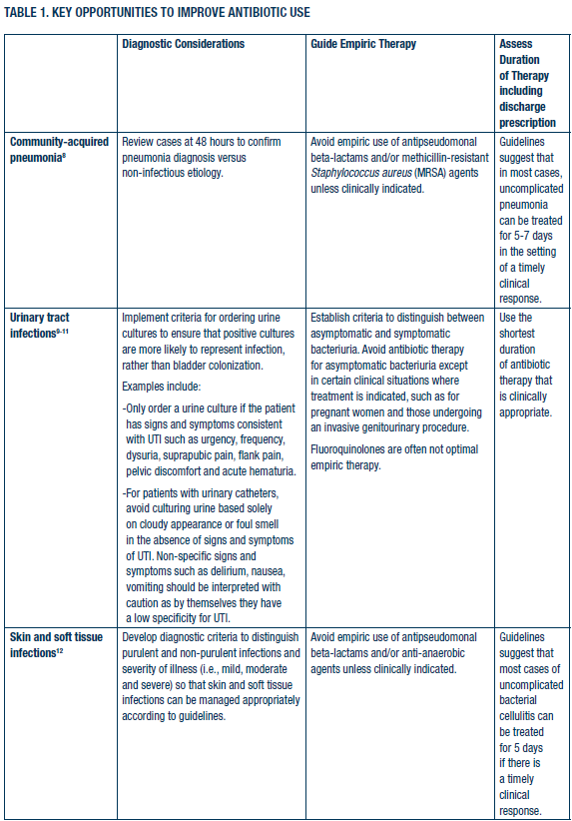
Action
CAP Pathway Intervention Objectives
Develop and implement single “Best Practice” pathway for CAP
Assess impact of Pathway on:
  Intravenous antibiotic duration
  Length of stay
  Costs
  Balancing Measures

Slide 48
Action
Targets of Intervention
Do away with Healthcare-associated Pneumonia (HCAP) diagnosis that promotes unnecessary broad-spectrum antibiotic use
IV to PO conversion (make it happen more quickly)
Duration of therapy (target 5 days)

Slide 49
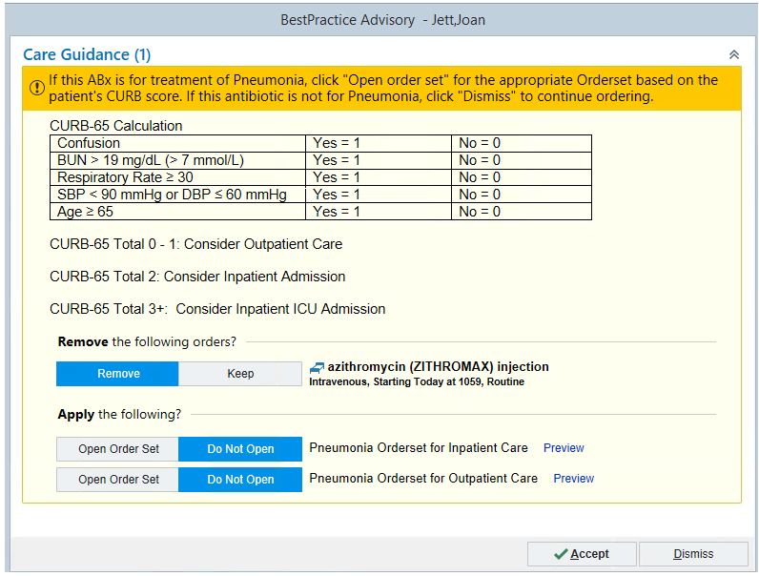
How It Works
*Fires when chest x-ray and antibiotics both ordered…embedded into workflow

Slide 50
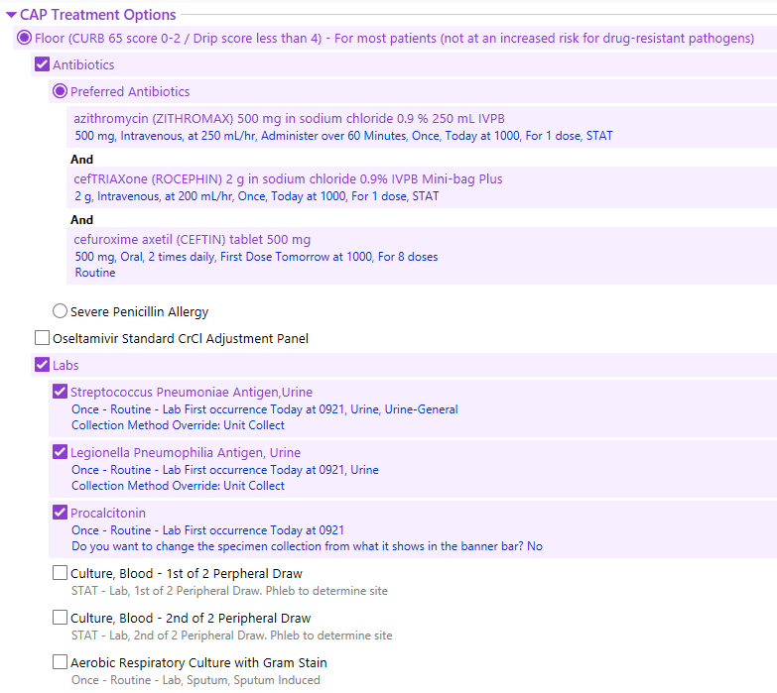
*Daily ASP Prospective Audit and Feedback

Slide 51
Tracking and Reporting
Measurement is critical to identify opportunities for improvement and to assess the impact of interventions.
Summary information on antibiotic use and resistance along with ASP processes and outcomes should be shared regularly with hospital staff, leadership, and the hospital board.
Electronic reporting to the NHSN Antimicrobial Use (AU) Option is important for hospitals to monitor and benchmark AU.

Slide 52
Tracking and Reporting
The AU Option provides a risk-adjusted benchmark of AU called the Standardized Antimicrobial Administration Ratio or “SAAR.”
Benchmarking has proven to be a powerful tool in hospital quality improvement.
ASPs are using the NHSN AU Option and the SAAR to both inform and assess interventions.

Slide 53
NHSN AU Option
Tracking and Reporting
Hospitals can track SAAR data over time and across eligible patient care locations and report findings to back to staff and hospital leadership
Data for example only

Slide 54
Tracking
Hospitals participating in NHSN’s AU Option report DOT and days present
181 critical access hospitals have reported to the AU Option
Percentage of hospitals meeting select Tracking criteria | General acute care | Children's | Surgical | Critical access
 | n=3572 | n=95 | n=146 | n=1144
Our facility has a policy or formal procedure for required documentation of indication for antibiotic orders and our ASP team monitors adherence to it | 61.4% | 67.4% | 62.3% | 55.1%
Providers have access to facility- or region-specific treatment guidelines or recommendations for commonly encountered infections and our ASP team monitors adherence to them | 77.0% | 75.8% | 74.0% | 70.0%
Our stewardship team monitors antibiotic resistance patterns (either facility- or region-specific) | 92.7% | 91.6% | 76.0% | 79.6%
Our stewardship team monitors antibiotic use in days of therapy (DOT) per 1000 patient days or days present, at least quarterly | 75.8% | 83.2% | 50.7% | 59.3%

Slide 55
Reporting
NHSN provides AU case examples, a SAAR guide, and an AU Data Report
Hospitals can use these to identify where improvements can be made, see examples of how hospitals have made improvements, assess national AU data to aid in benchmarking, and report these data back to staff & leaders
Percentage of hospitals meeting Reporting criteria | General acute | Children's | Surgical | Critical access
 | n=3572 | n=95 | n=146 | n=1144
Our facility has a policy or formal procedure to review courses of therapy for specific antibiotic agents and provide real-time feedback and recommendations to the treating team (i.e., PAF) | 74.9% | 81.1% | 58.2% | 47.1%
Our facility monitors AU in DOT, DDD, or some other way and provides individual-, unit-, or service-specific reports to prescribers, at least annually | 56.5% | 60.0% | 47.3% | 51.4%
Our ASP team provides updates to facility leadership on AU and stewardship efforts at least annually | 92.9% | 93.7% | 91.8% | 83.0%
Our stewardship team provides updates to staff on outcomes for antibiotic stewardship interventions at least annually | 64.0% | 64.2% | 48.0% | 47.8%

Slide 56
Tracking and Reporting
Measurement
Basic: Process Measures
  Specific steps in a process that lead — either positively or negatively — to a particular outcome metric.
Intermediate: Outcome Measures
  High-level clinical or financial outcomes that concern healthcare organizations and providers.
Advanced: Antibiotic Use Measures
  Can be viewed as either process or outcome measure.

Slide 57
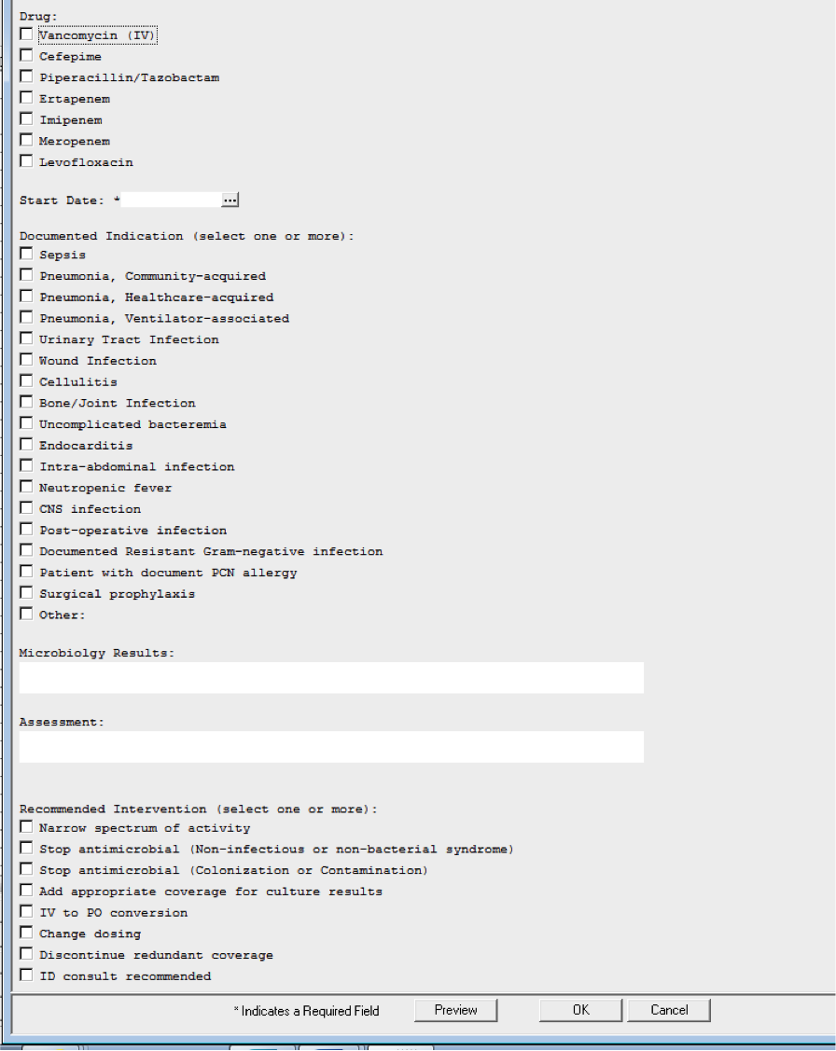
Prospective Audit and Feedback Note

Slide 58
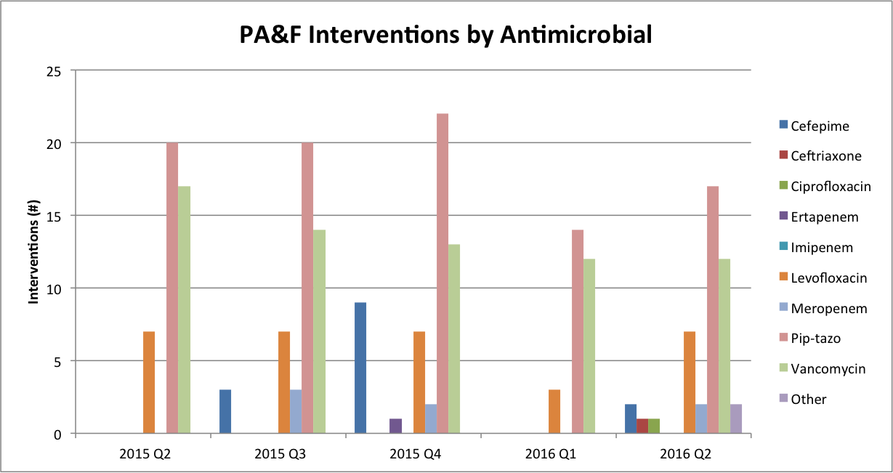
Prospective Audit and Feedback Tracking

Slide 59
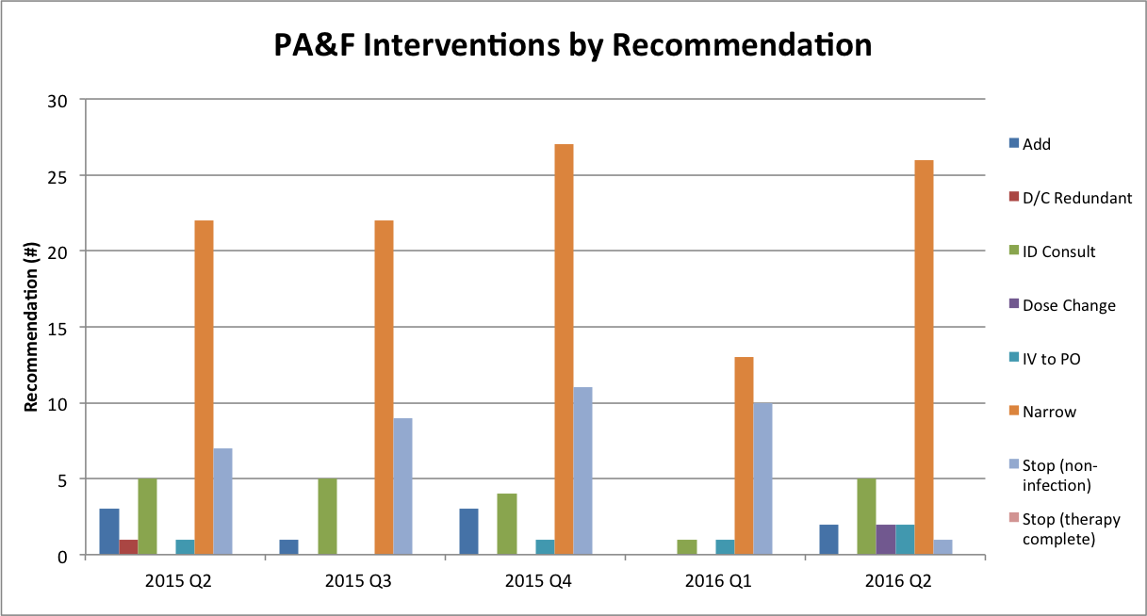
Prospective Audit and Feedback Tracking

Slide 60
Tracking and Reporting
Outcome Measures
Tracking antibiotic resistance patterns (e.g. antibiogram)
C. difficile infection (CDI) rates
30-day mortality and readmission rates for CDI or common infection (e.g. CAP)
Length of stay
Adverse drug events
$$$

Slide 61
Antibiotic Use Measures from
Community-Acquired Pneumonia Intervention
Ceftriaxone
Cefuroxime

Slide 62
Process and Outcome Measures from Community-Acquired Pneumonia Intervention
 | Pre-Intervention (9/2016 – 8/2017) N = 411 | Post-Intervention (9/2017 – 6/2018) N = 368 | ^P Value
Procalcitonin Ordered, n (%) | 197 (47.9) | 274 (74.5) | <0.001
Urine antigens ordered, n (%) | 304 (74.0) | 305 (82.9) | 0.003
IV-ABX duration in days, median (IQR) | 3.00 [2.00, 5.00] | 2.00 [1.00, 4.00] | <0.001
Median LOS, days (IQR) | 3.69 [2.08, 6.58] | 3.08 [1.97, 4.99 | 0.014
Mortality, n (%) | 33 ( 8.0) | 17 ( 4.6) | 0.07
30 Day Readmission, n (%) | 18 ( 9.1) | 22 ( 12.5) | 0.37
Relative Mean Cost (CV*) | 1.00 (3.06) | 0.65 (1.38) | 0.02

Slide 63
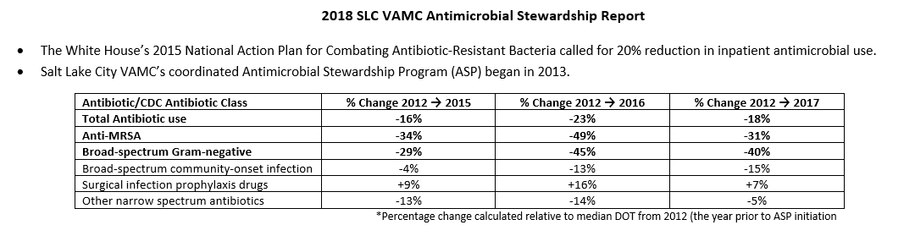
Example ASP Report

Slide 64
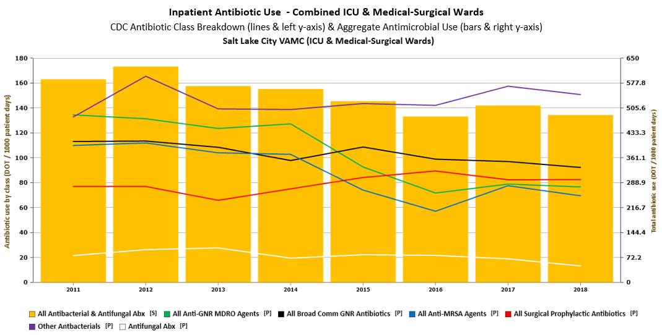

Slide 65
Education
Education is most effective when paired with interventions and measurement of outcomes.
Case-based education can be especially powerful, so prospective audit with feedback and preauthorization are both good methods to provide AU education.
This can be especially effective when the feedback is provided in person, for example through handshake stewardship.

Slide 66
Education
Education is the element with lowest uptake (across all facility types), although nationally reported uptake has increased from 62% in 2014 to 93% in 2019
Percentage of hospitals meeting Education criteria | General acute care | Children's | Surgical | Critical access
 | n=3572 | n=95 | n=146 | n=1144
Prescribers receive education on appropriate AU at least annually | 82.9% | 84.2% | 73.3% | 75.3%
Nursing staff receive education on appropriate AU at least annually | 57.4% | 60.0% | 53.4% | 52.9%
Pharmacists receive education on appropriate AU at least annually | 85.8% | 81.1% | 84.9% | 74.7%

Slide 67
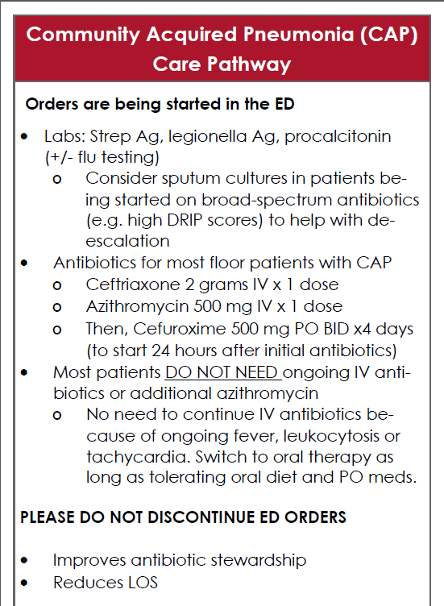
Education
Presentation to stakeholders and house staff
  Targeted talk about CAP
Partnered with hospitalists
Education through prospective audit and feedback
2020 – Started Zoom ASP Grand Rounds with medicine pharmacists

Slide 69
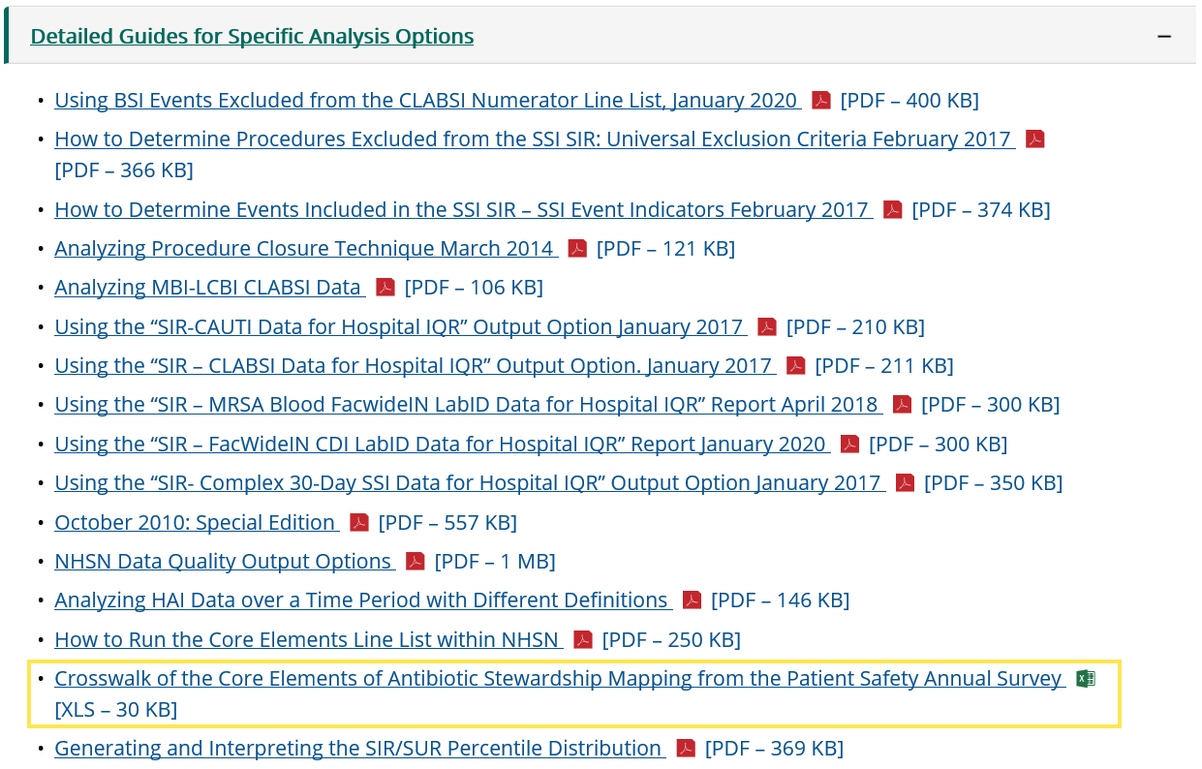
Crosswalk of the hospital Core Elements and antibiotic stewardship mapping from patient safety annual survey
https://www.cdc.gov/nhsn/ps-analysis-resources/reference-guides.html

Slide 70
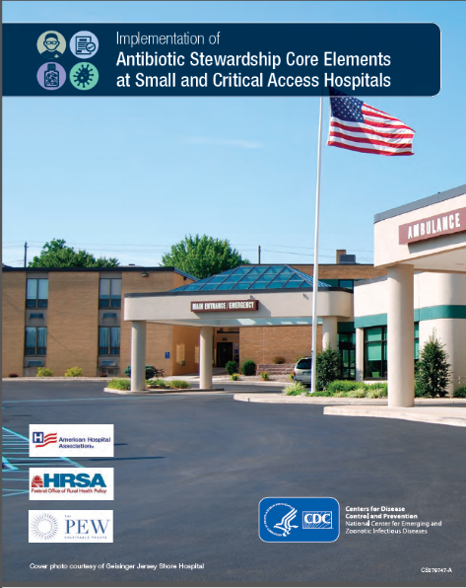
Implementation of Antibiotic Stewardship Core Elements at Small and Critical Access Hospitals
Developed by CDC in collaboration with:
  Federal Office of Rural Health Policy
  The American Hospital Association
  The Pew Charitable Trusts
https://www.cdc.gov/getsmart/healthcare/implementation/core-elements-small-critical.html
Notes:
Recommendations “from small and critical access hospitals for small and critical access hospitals”

